Slide 1
2021 Bargaining/Strike Information for Students
Follow the UOIT Faculty Association on Social Media for Important Updates and Ways To Get Involved
facebook.com/uoitfa
twitter.com/uoitfa
instagram.com/uoitfa

Slide 2
Help the Faculty Association Avert a Strike!!
You can help us avoid a strike by sending a letter in support of high-quality education at Ontario Tech.
www.uoitfa.ca/take-action
The more messages we send to Ontario Tech, the greater chance we can avoid a strike.
In the last round of bargaining, we were able to send 1000s messages to the University which helped us avert a strike.

Slide 4
We care about the quality of education our students receive
We care about the fact that we have less time to spend with our students than faculty at almost any other university in Canada
We care about prioritizing research and ensuring that researchers are supported properly by Ontario Tech
We care about building a more equitable institution where female faculty aren’t paid an average of 13% less than men for the same work
Faculty Working Conditions are Student Learning Conditions!!
For more information about the potential of a strike at Ontario Tech go to: https://www.uoitfa.ca/uoitfastudentfaq/

Slide 5
Conciliation: A process offered by the Ministry of Labour to provide help in reaching a collective agreement. Conciliation is mandatory before the parties can engage in a strike or lockout.
Step 1: Either party may apply to the Ministry for a conciliator.
Step 2: A conciliator is appointed by the Ministry.
Step 3: A Conciliator assists the parties during the bargaining process to negotiate a collective agreement.
Step 4: If an agreement cannot be reached with the assistance of a conciliator than either party may request a no board report from the Conciliator.
Step 5: Once the conciliator issues the no board report, there is 17-day period before the parties enter a legal strike or lockout position.
If the FA requests the no board report it would be considered a strike whereas if the Employer requests the no board it would be a lockout.

Slide 6
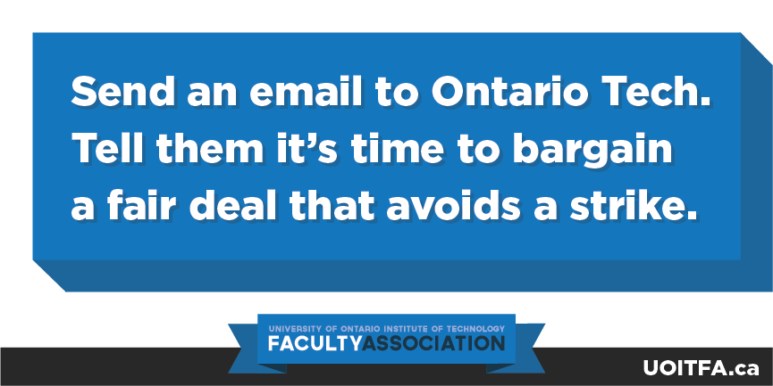
Social media day of action Jan 18 | #uoitfacares

